Slide 1
Team 3 DJ KL
Derek Xu, Jivesh Jain, Koen Lin, Louis Jimenez-Hernandez

Slide 2
Project title, project members – this should be a single slide
2. Goal/Motivation –what you are doing and why. This slide should include 1 concrete example
of how someone could actually use your design in real life.
3. Short Functionality – one slide max recapping what you are doing. What was your design
supposed to do?
4. Short Specification – one slide max recapping the specification of the design. What were the
requirements? Constraints?
5. Detailed Block Diagrams – provide the real block diagrams for your design.
6. Code Snippet – provide 1 or 2 of your best code snippets and discuss. What was unique
about it? Challenging? Innovative?
7. Successes – discuss how your project was successful and why.
8. Failures – discuss how your project did not work out as you planned. Provide examples of
what you would do differently.

Slide 3
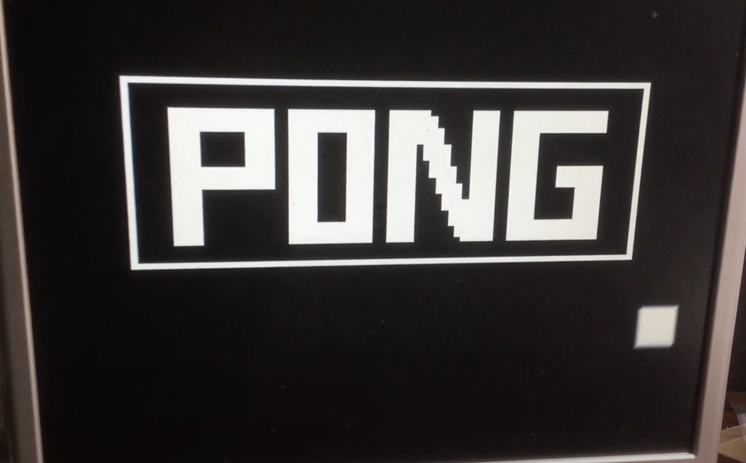
Goal
Our goal was to adapt the One Player Pong project from 2020 and expand upon it to be a more traditional Two Player Pong game.
We chose to do this project because making a video game was something that is fun for us to work on.
Real life usage: Emulate playing Pong using our project.

Slide 4

Functionality
A fully playable two player game of Pong with modified rules
Lives system instead of normal score system

Slide 5
Specifications
Requirements:
Has to output onto display
Take two separate user inputs and display their lives
Player and ball movement and collision
Lives and game conditions
Constraints:
Power - FPGA is not very strong which limited us to a simpler game
Lack of I/O - Board lacks a good interface for two players to interact at once
Screen Size

Slide 6
Meeting Specifications
Display: Utilizing the VGA output on the FPGA board
Input: Two sets of buttons on board or keyboard input
Lives: 7-segment display
Collisions: Match X and Y positions of paddle, ball, and borders
Game Conditions: Game top level keeping track of lives and state

Slide 7
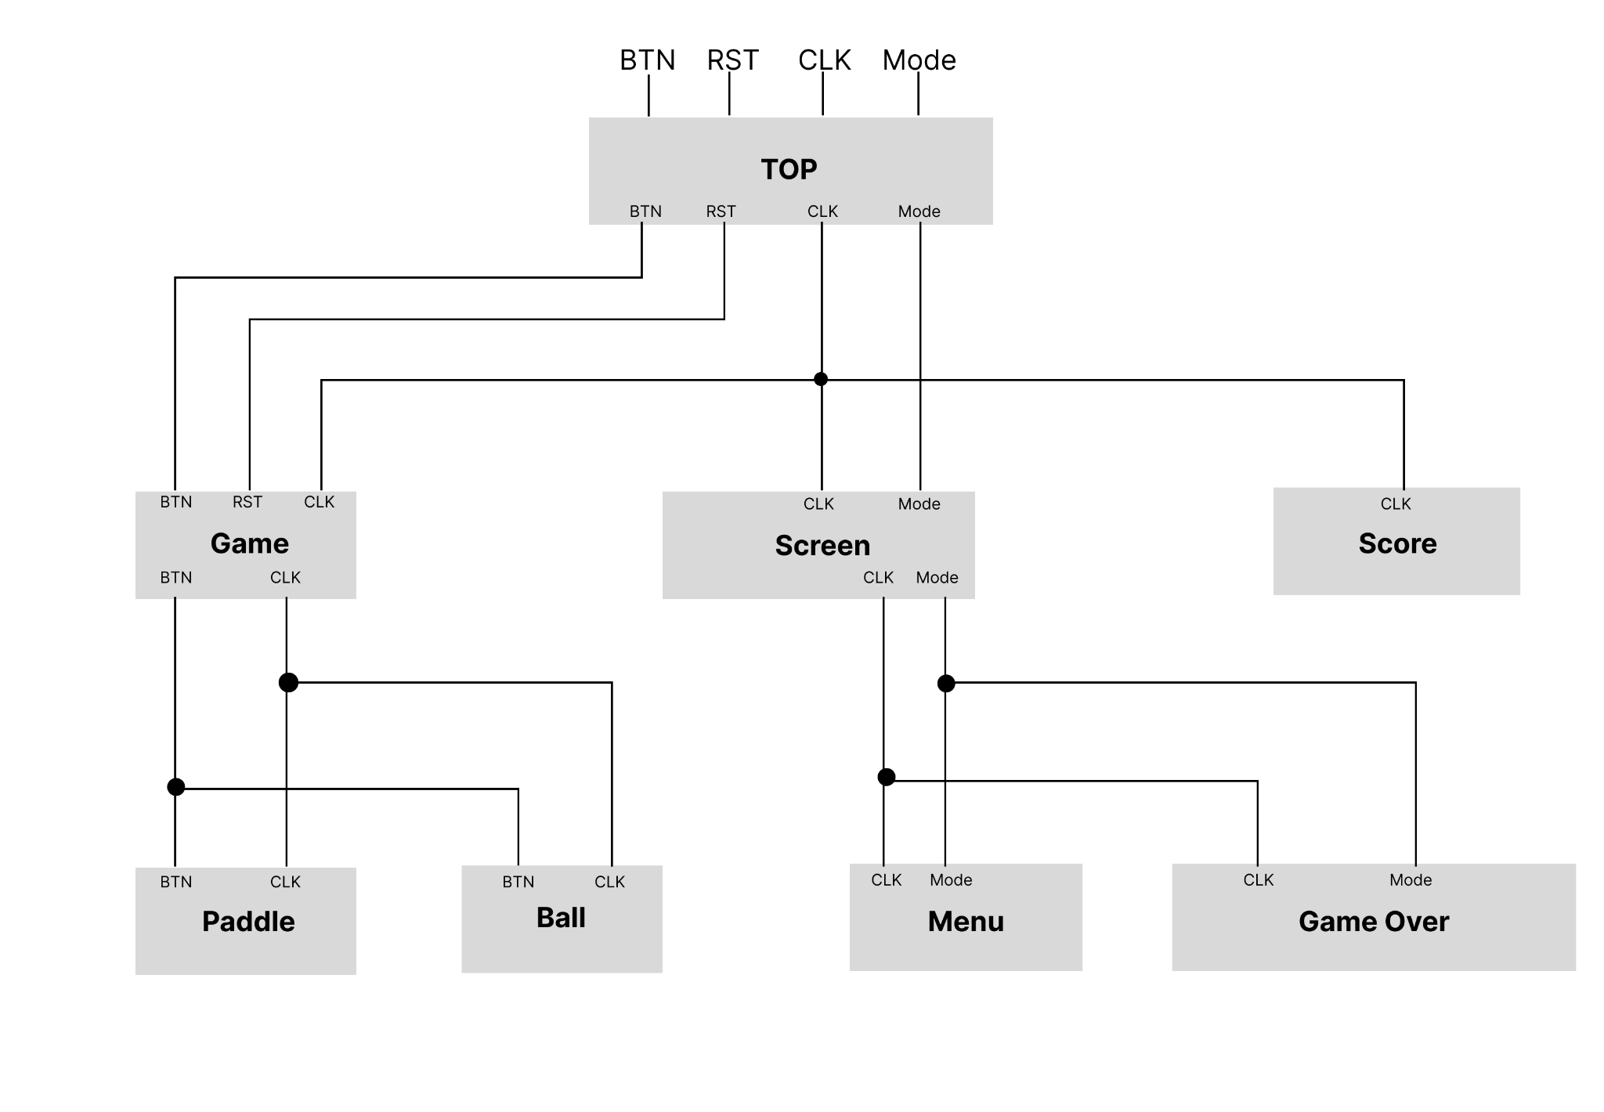
Block Diagram

Slide 8
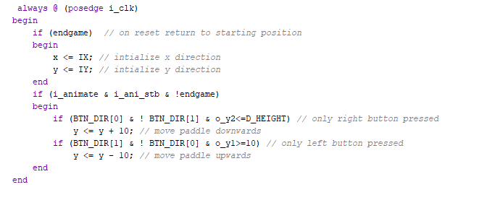
Code

Slide 9
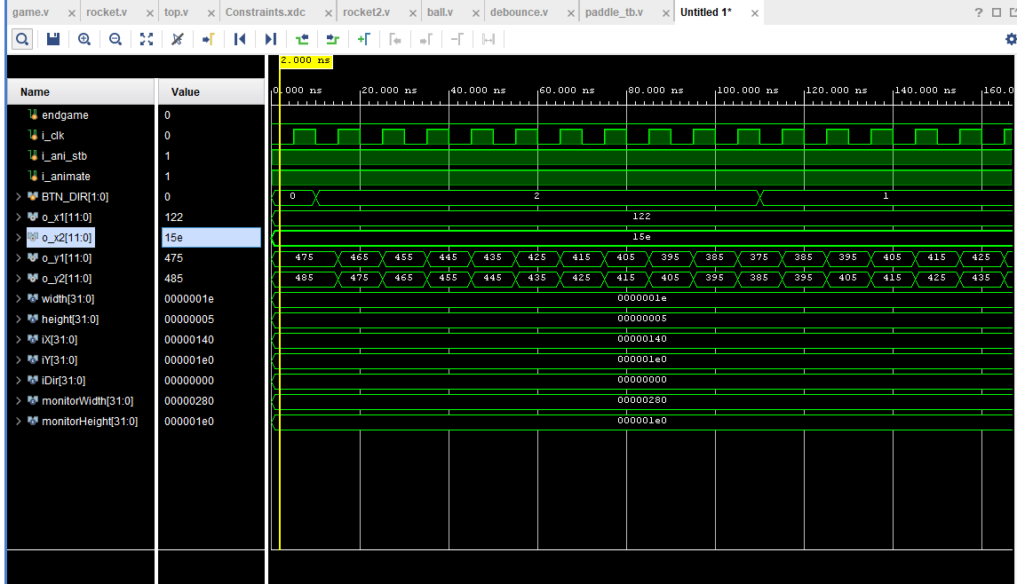

Slide 10
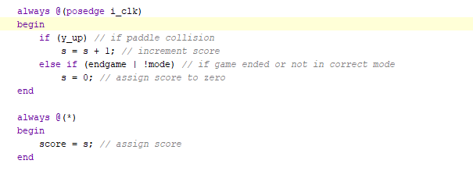
Code
Scoring rule set needs to be augmented
Endgame condition needs to be changed.

Slide 11
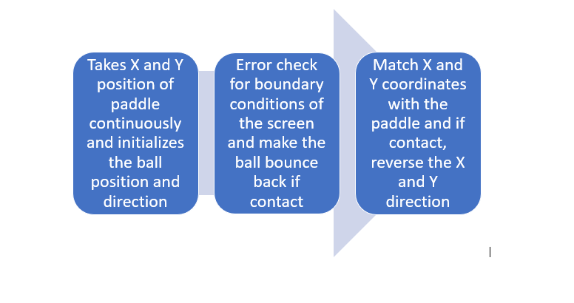
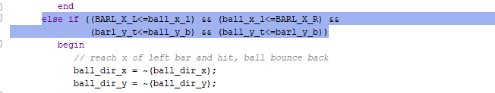
Logic For Collision Detection

Slide 12
Successes
Two Players
VGA Display is functional
Buttons function to control our players
Paddles move with player input
Ball and borders collide
Player paddles have bounded movement

Slide 13
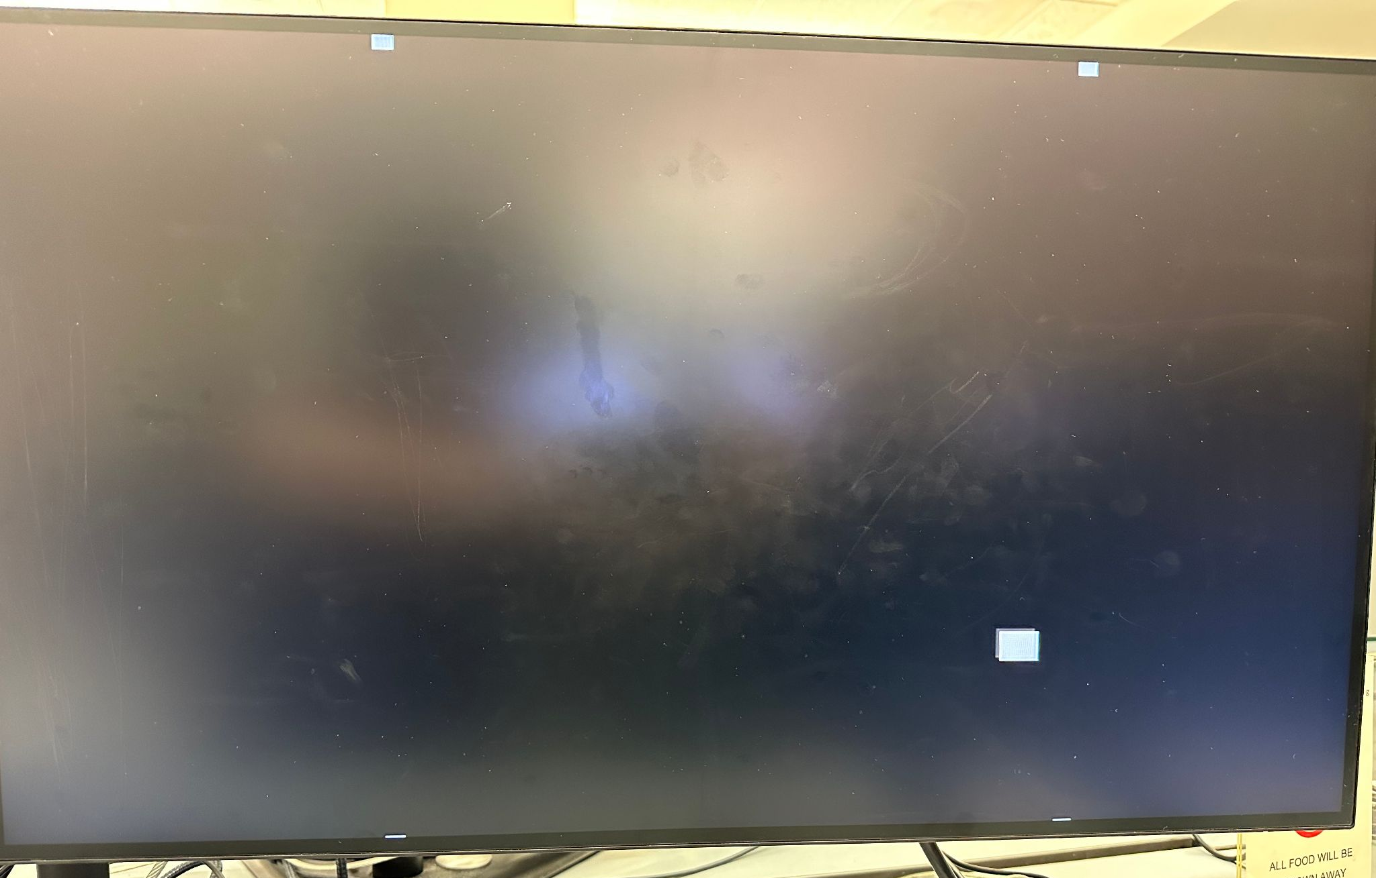
Failures
Scoring Mechanism not operational yet.
Game over conditions are still the original(Need to implement new ruleset)
Ball and paddles do not have collision yet
Paddle movement bounding is glitchy
Paddle wraps to other side of screen before stopping

Slide 14
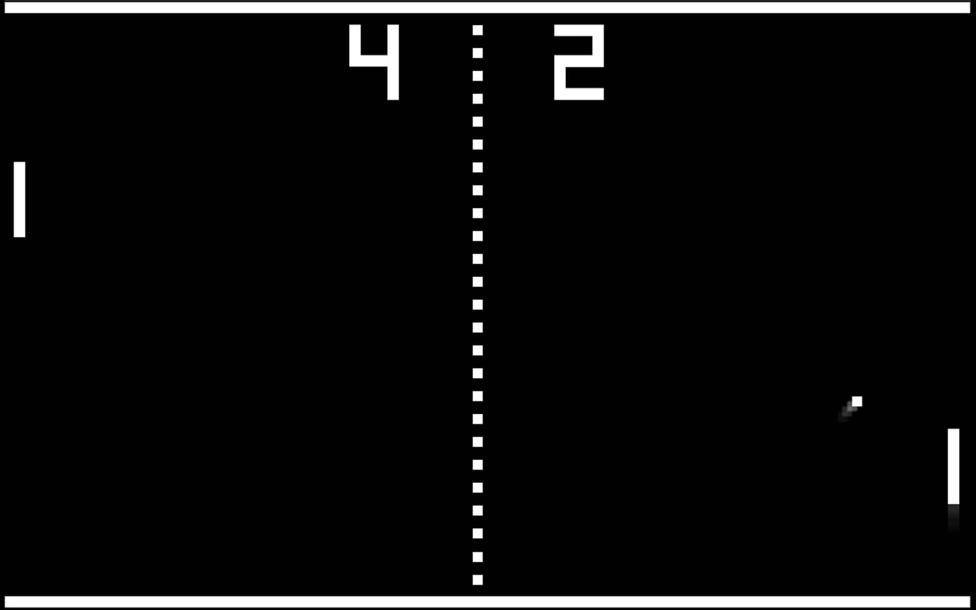
Features to Add
Lives counter on Seven Segment Display
Trigger game over once a player runs out of lives
Keyboard functionality - Closer to Air Hockey
WASD for player 1
Arrow keys for player 2
Increasing speed of the ball
Make ball round

